Slide 1









My Number Interactive Notebook
$$×$$
$$\frac{1}{2}$$
$$÷$$
$$+$$
$$−$$
$$\frac{3}{5}$$
$$7$$
Name
Class
Teacher
Term 1 Semester 1
$$5^{2}$$
$$\sqrt{9}$$
1

Slide 2
Create your own front page
It needs to contain the following –
My number interactive notebook
Name
Class
Teachers Name
Semester 1 Term 1
Page number 1

Slide 3
Contents
Glossary or Formula Page
Page
Date
Description
2
3

Slide 4
Tasks
24
7
30
Essential Question
Questions
Notes
Summary
4

Slide 5
24
7
30
Date
Multiplication and DivisionStrategies
EQ – What strategies we can use to multiply and divide mentally?

Slide 6
24
7
30
Date
Multiplication and DivisionStrategies
EQ – What strategies we can use to multiply and divide mentally?
The commutative and associative laws
Multiplication can be done in any order. The associative and commutative laws do not hold for division (in the same way that they hold for addition but not for subtraction).

Slide 7

24
7
30
Date
Multiplication and DivisionStrategies
EQ – What strategies we can use to multiply and divide mentally?
The associative laws
Multiplication can be done in any order and can be grouped in any way. The associative law does not hold for division (in the same way that they hold for addition but not for subtraction).
The Associative Law:
$$\left(a × b\right) × c = a × (b × c)$$

Slide 8

24
7
30
Date
Multiplication and DivisionStrategies
EQ – What strategies we can use to multiply and divide mentally?
The associative laws
Multiplication can be done in any order and can be grouped in any way. The associative law does not hold for division (in the same way that they hold for addition but not for subtraction).
The Associative Law:
$$\left(a × b\right) × c = a × (b × c)$$

Slide 9
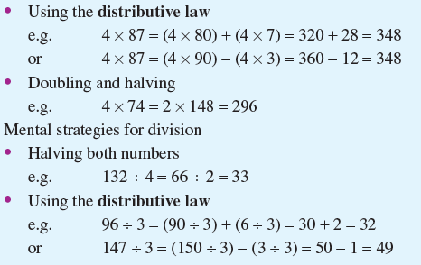
24
7
30
Date
Multiplication and DivisionStrategies
EQ – What strategies we can use to multiply and divide mentally?

Slide 10

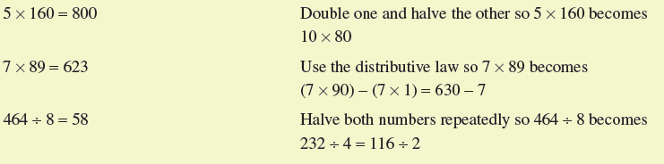
24
7
30
Date
Multiplication and DivisionStrategies
EQ – What strategies we can use to multiply and divide mentally?

Slide 11
24
7
30
Date
Multiplication and DivisionStrategies
EQ – What strategies we can use to multiply and divide mentally?
Discussion:
Can you think of and describe any other strategies that you use?

Slide 12
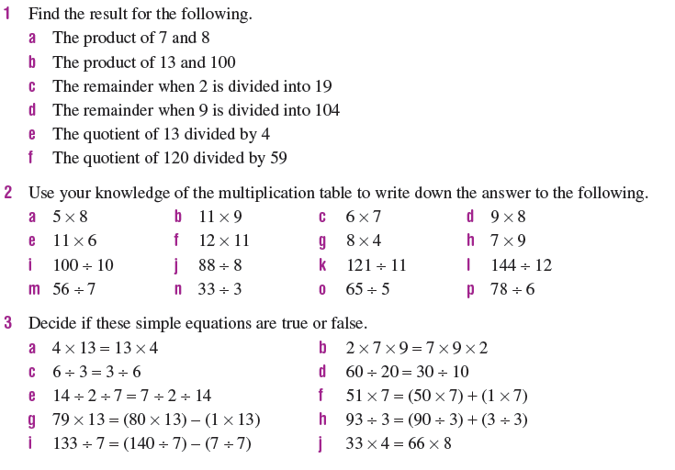
Task

Slide 13
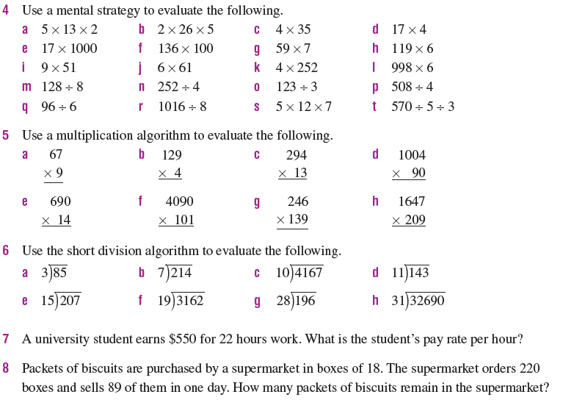
Task

Slide 14
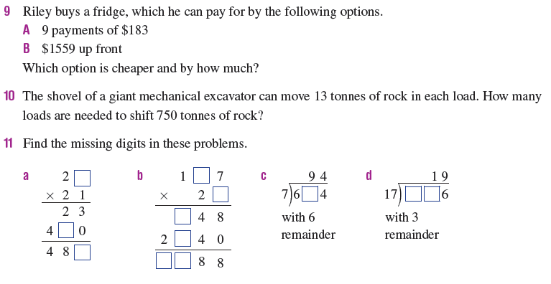
Task

Slide 15
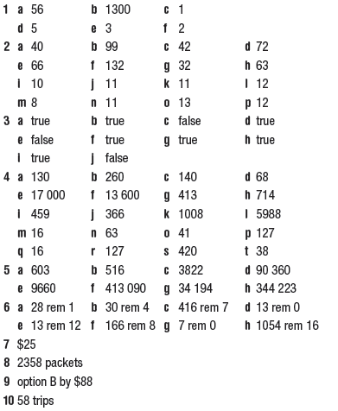

Answers

Slide 16
Notes Review
24, 7 ,30
Date
Title
Essential question
Notes complete
Notes complete with colour and diagrams
Questions completed
Contents page filled in
Formula page filled in

Slide 17
Homework
Review your notes and write a summary answering the essential question.

